Slide 1
Lidar Intensity Image Human Skeleton Extraction
Zhaoyang(Mike) Wang

Slide 2
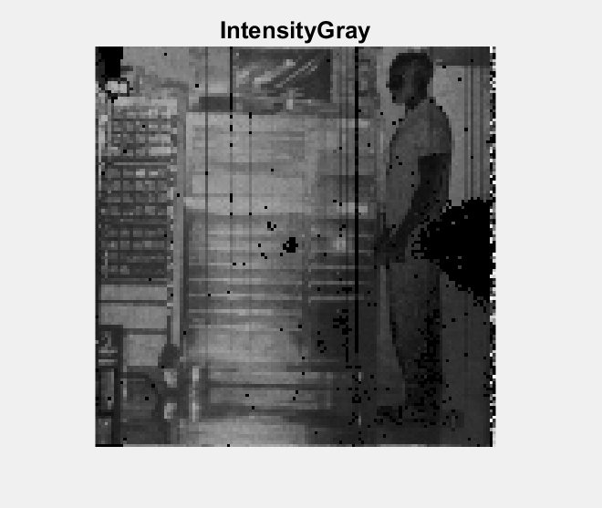
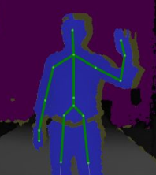
Data and Task
TigerCub Lidar Intensity Image with Human
(128x128)
Extract Human Skeleton

Slide 3
Flow Chart
Preprocess
Skeleton Extraction
Dead Pixel Fix
Neural Gas Network Domain
Human Detection
Image Domain
Edge Extraction

Slide 4
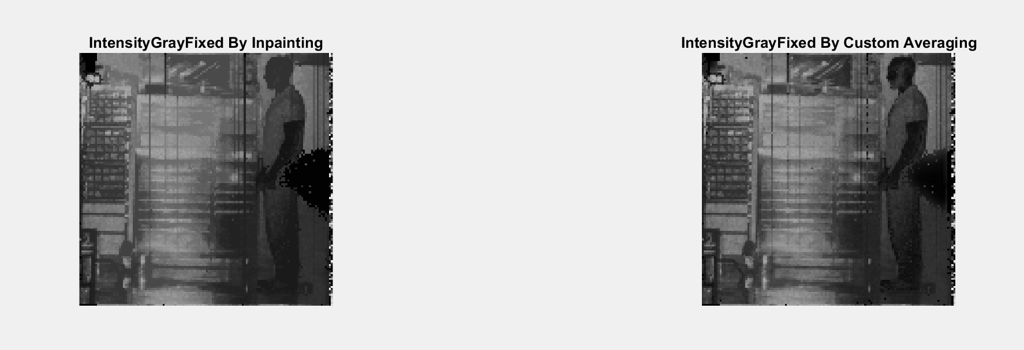
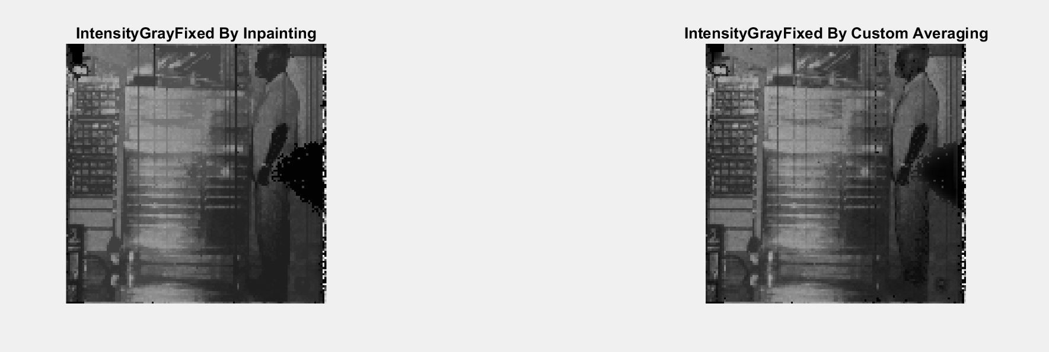
Dead Pixel Fix
Dead Pixel Fix
Inpaint (Imfill)
Averaging
Imfill: fill in an area with dark pixels surrounded by lighter pixels
Averaging: Replace the dead pixel with surrounding average

Slide 5
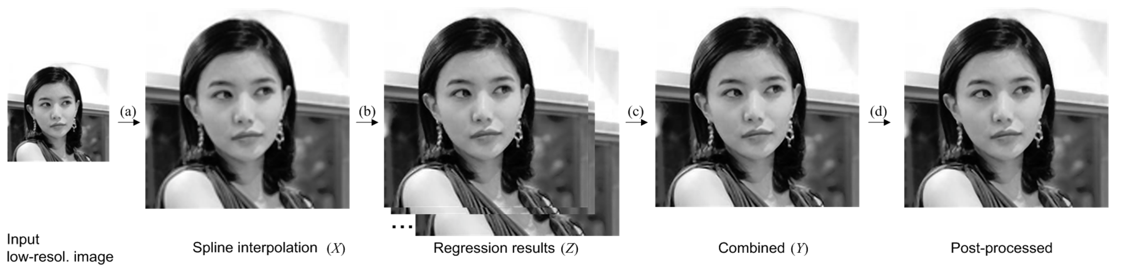
Low Resolution Problem
Dead Pixel Fix
Upsampling
Higher Resolution
Single Image Superresolution
Human Detect

Slide 6
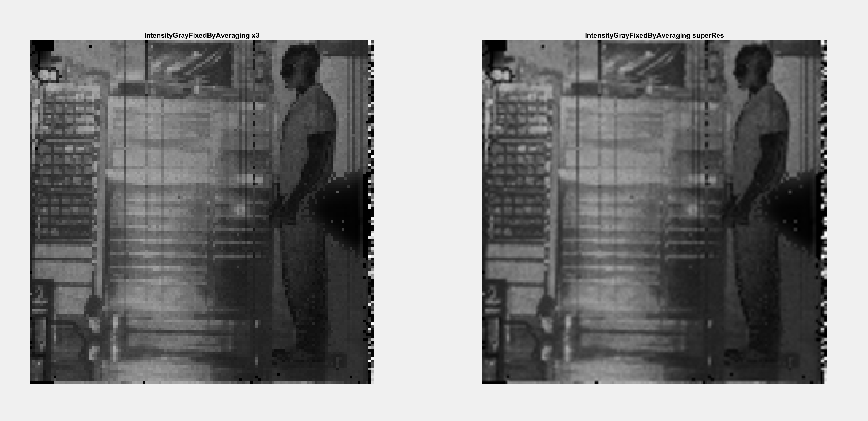
Upsampling(Bicubic) v. SuperResolution

Slide 7
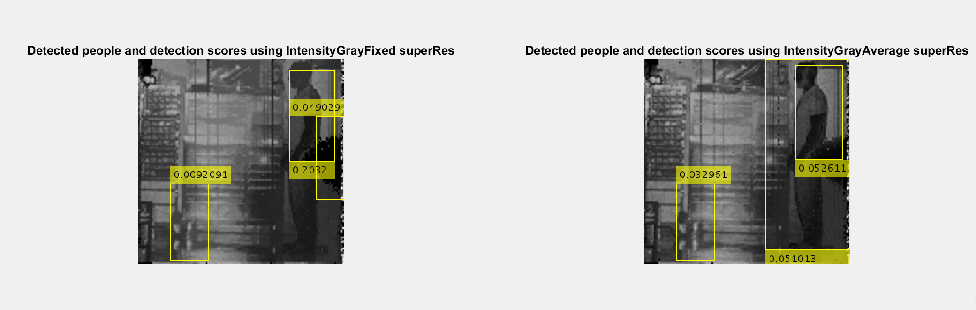
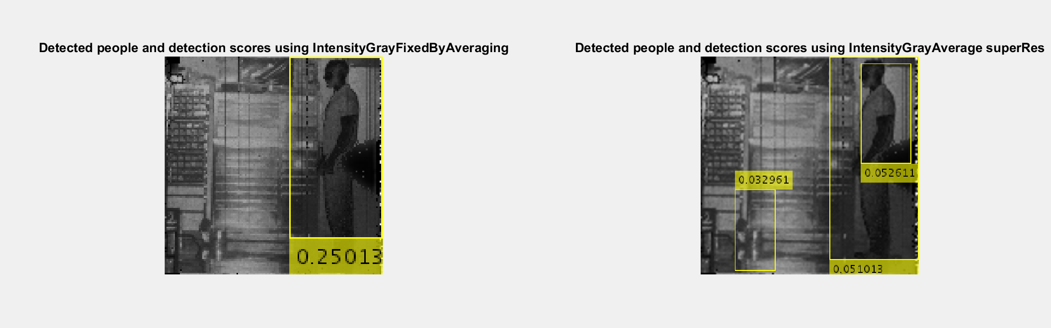
People Detection
People Detection
People Detector
Higher Resolution
Standing Upright
Tight Threshold

Slide 8
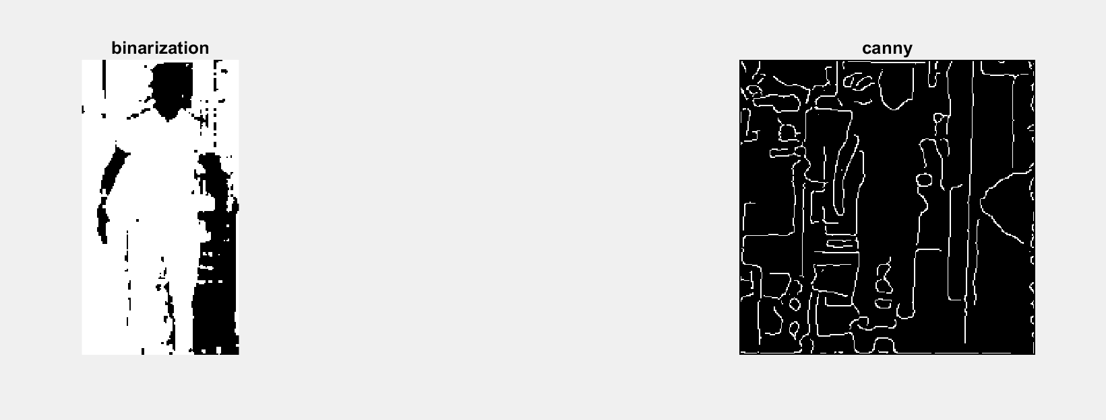
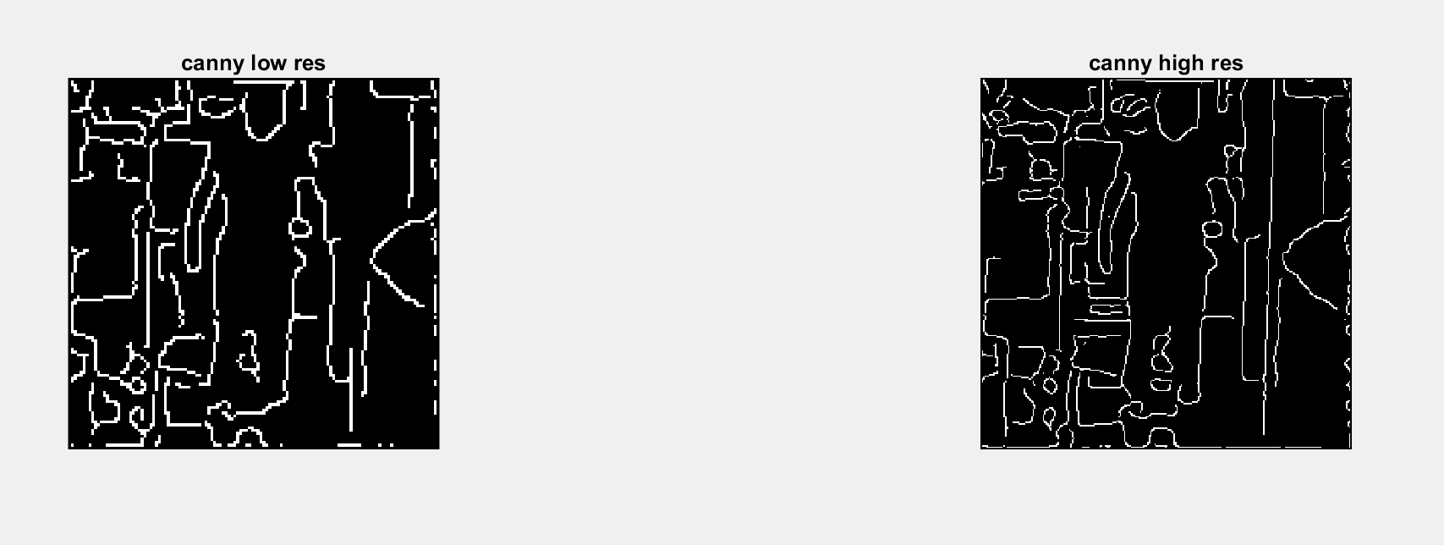
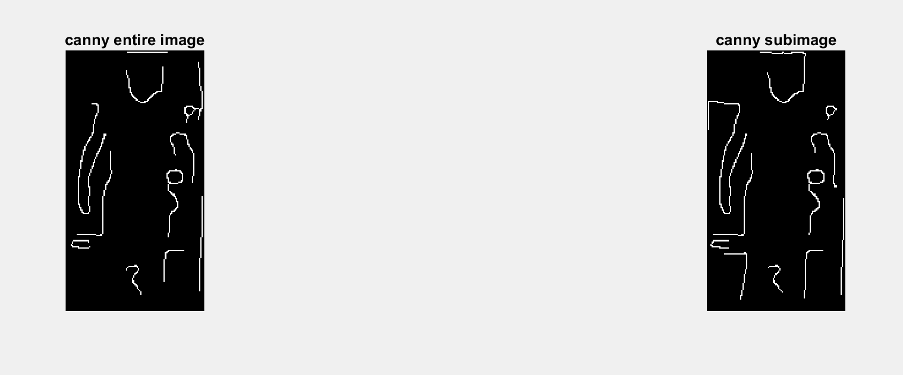
Edge Detection / Human Separation
Edge Detection
Edge Detectors
Image Binarization
Entire Image
Human Subimage
Additional Refinement
(Remove Spur Pixels, areaopen and clear border pixels, etc)

Slide 9
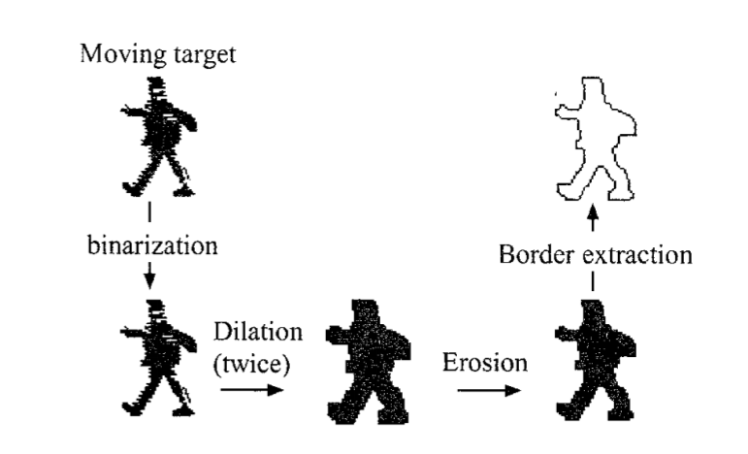
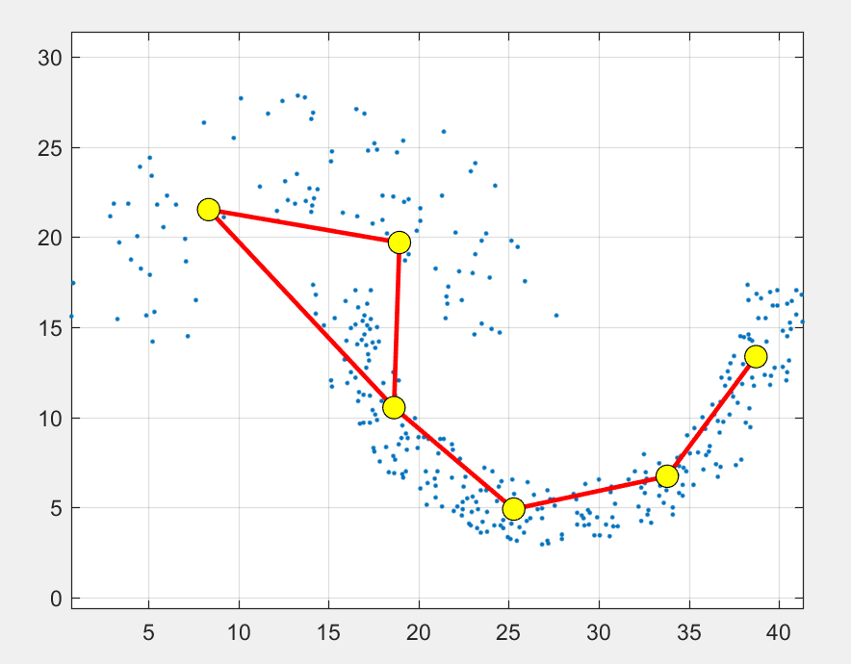
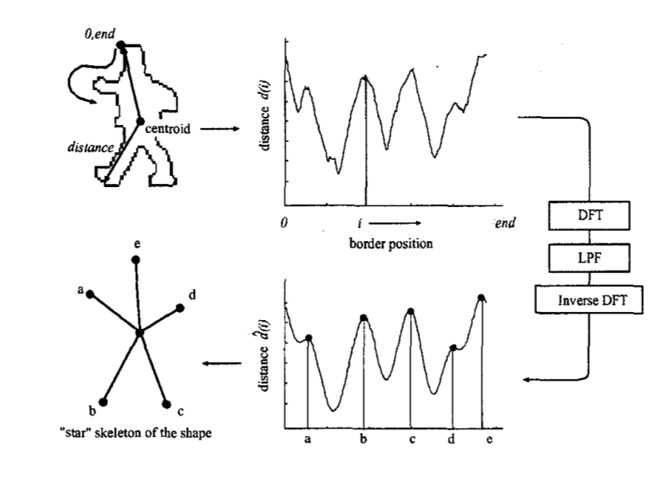
Skeleton Extraction
Skeleton Extraction
Neural Gas Network
Star Skeleton

Slide 10
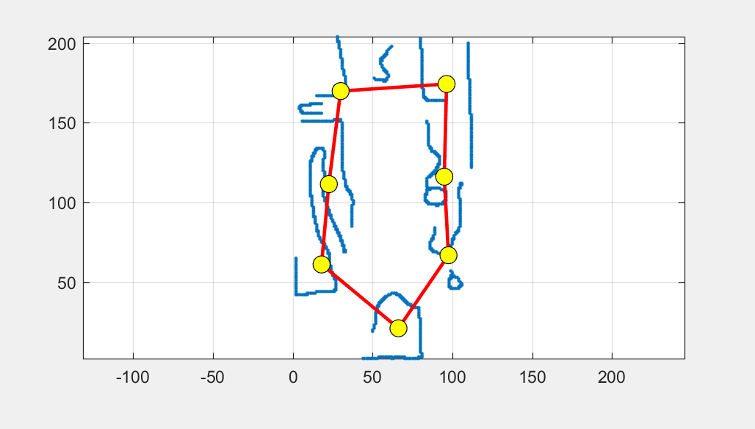
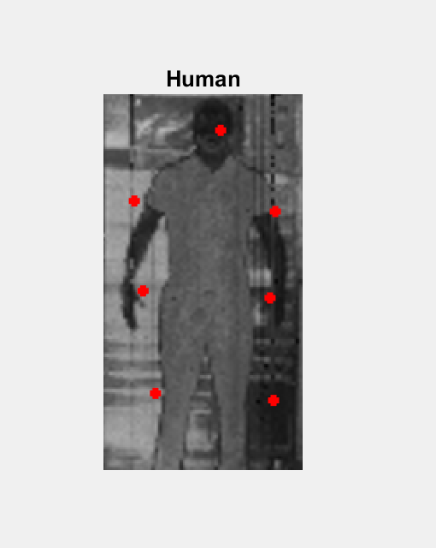
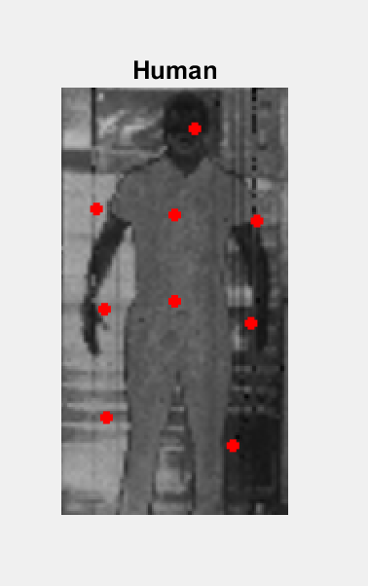
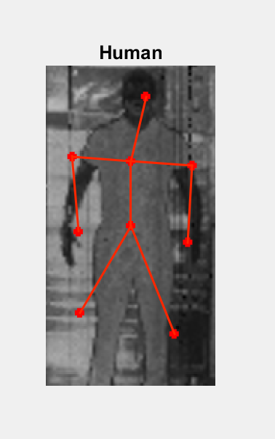
Neural Gas Network
Neural Gas Network
Parameters
Max Iteration
Image Domain Representation
Key Points

Slide 11
Limitations and Future Work
Limitations:
Detects only human standing upright
Computation Speed (not ideal for real-time analysis)
Different parameter numbers at different posture
Future Work:
Better Preprocessing to produce a continuous contour of human
Adjust people detector to detect people with various height width ratio (instead of 2:1)
Better Initialization of NGN for each consecutive frame (improve speed)
Tune NGN for stable convergence result

